Slide 1

House Price Predict
cui wei 2020-04-10
——— a brief introduction

Slide 2
What problem do we want to solve？

Slide 3
Predict house sales prices and practice feature engineering

Slide 4
what is the problem? What is our approach?
Ask a home buyer to describe their dream house, and they probably won't begin with the height of the basement ceiling or the proximity to an east-west railroad. But this playground competition's dataset proves that much more influences price negotiations than the number of bedrooms or a white-picket fence.
With 79 explanatory variables describing (almost) every aspect of residential homes in Ames, Iowa, this competition challenges you to predict the final price of each home

Slide 5
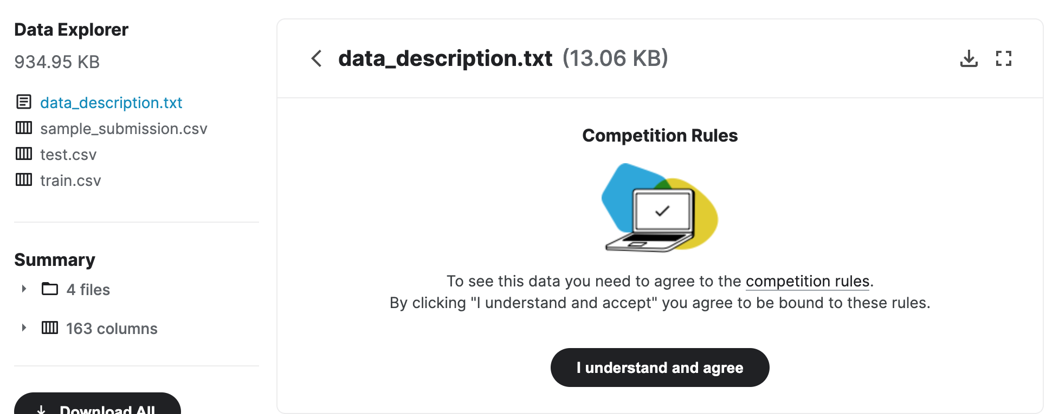
Where the dataset come from?

Slide 6
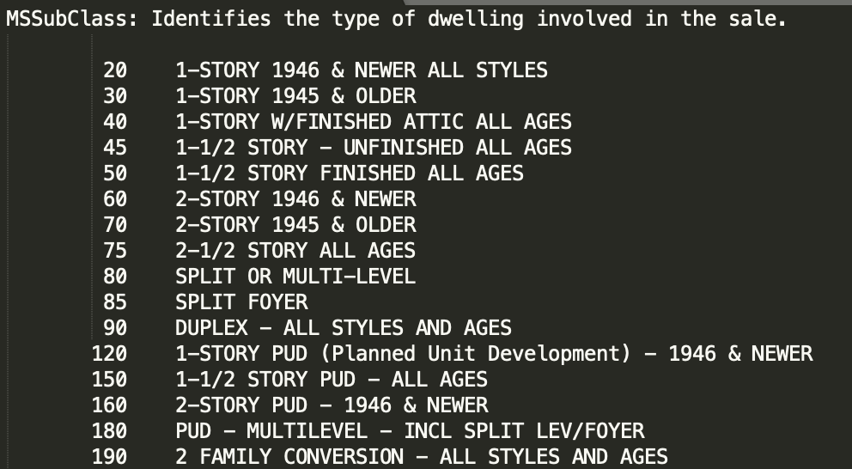
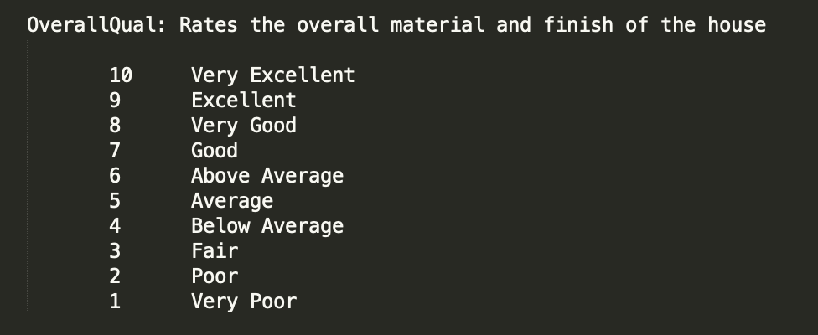
Where the data Description?

Slide 7
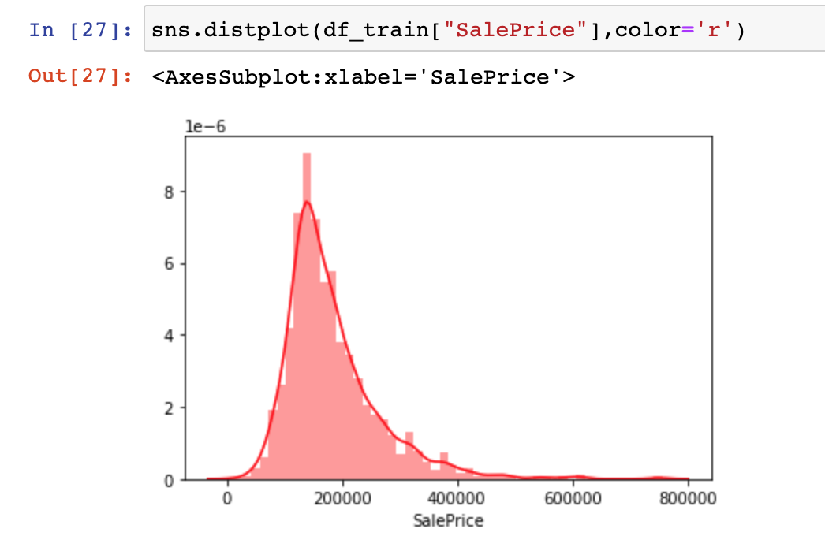
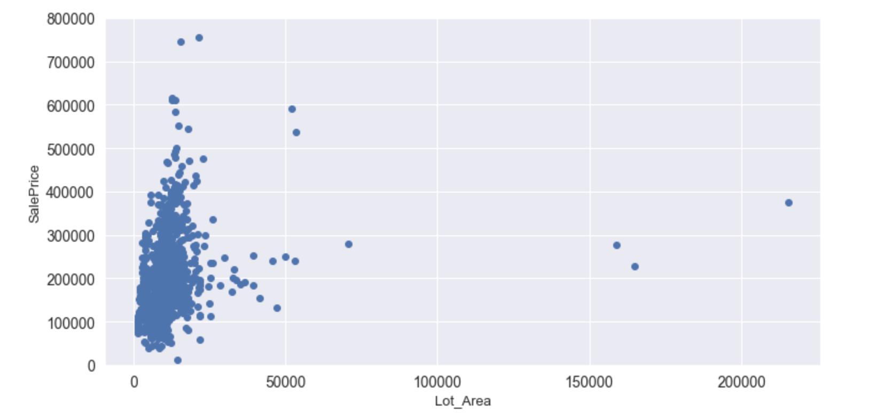
Data precessing

Slide 8
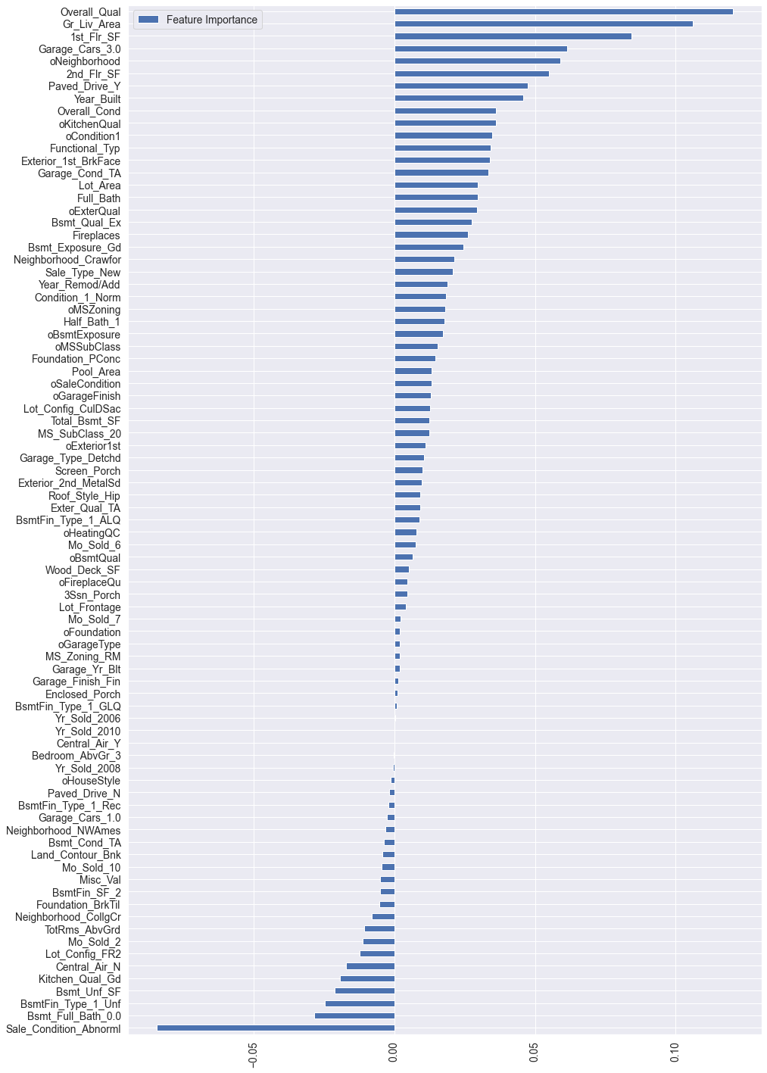
Feature importance refers to techniques that assign a score to input features based on how useful they are at predicting a target variable.

Slide 9
choose model to predict
12 algorithms and 5-fold cross-validation are used to evaluate the baseline effect:
LinearRegression
Ridge
Lasso
Random Forrest
Gradient Boosting Tree
Support Vector Regression
Linear Support Vector Regression
ElasticNet
Stochastic Gradient Descent
BayesianRidge
KernelRidge
ExtraTreesRegressor

Slide 10
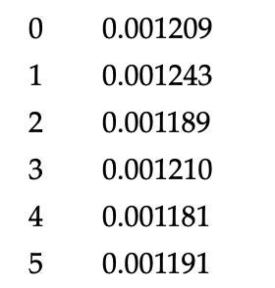
Result
After many long rounds of testing among all the models, SVR, KER are my best 2 models. If I use single model, I will choose from SVR and Kernel Ridge two models.

